Slide 1

EMAIL CLASSIFICATION AS ABUSIVE OR NON-ABUSIVE
AN NLP BASED PROJECT WHERE WE ARE REQUIRED TO PREDICT THE INCOMING EMAIL IF IT IS ABUSIVE OR NON-ABUSIVE BASED ON THE DATA PROVIDED.

Slide 2
Project Info
Name of the team | P_278Group_I
Date of formed | 09/08/2023
Mentor | Anavadhya C /Madishetti Raja Shekar
Team Members | Mr. Medidi Jayanth rama krishna Mr. Surendra Mr. Tejas Mr Rajveer Mr abishek Miss Pradnya
Meeting Days | Two meetings every week
Meeting Duration | 1 Hour

Slide 3
Project analysis slide 2
Project Analysis
PROBLEM ANALYSIS
BUSINESS OBJECTIVE
PROJECT
DATA CLEANSING(EDA)
MODEL DEVELOPMENT
VISUALISATION
MODEL DEPLOYMENT

Slide 4
Business Objective
Inappropriate emails would demotivates and spoil the positive environment that would lead to more attrition rate and low productivity and Inappropriate emails could be on form of bullying, racism, sexual favoritism and hate in the gender or culture ,in today's world so dominated by email no organization is immune to these hate emails.
The goal of the project is to identify such emails in the given day based on the above inappropriate content

Slide 5
EDA
We have 5 columns in the dataset :-
Unnamed: 0: Unique identifier.
filename: Name of the file.
Message-ID: Unique identifier for emails.
content: The actual content of the emails.
Class: The classification label for the emails
➔ we are using content and class for further process and trying to get the information about abusive and non-abusive mails

Slide 6
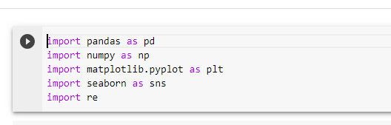
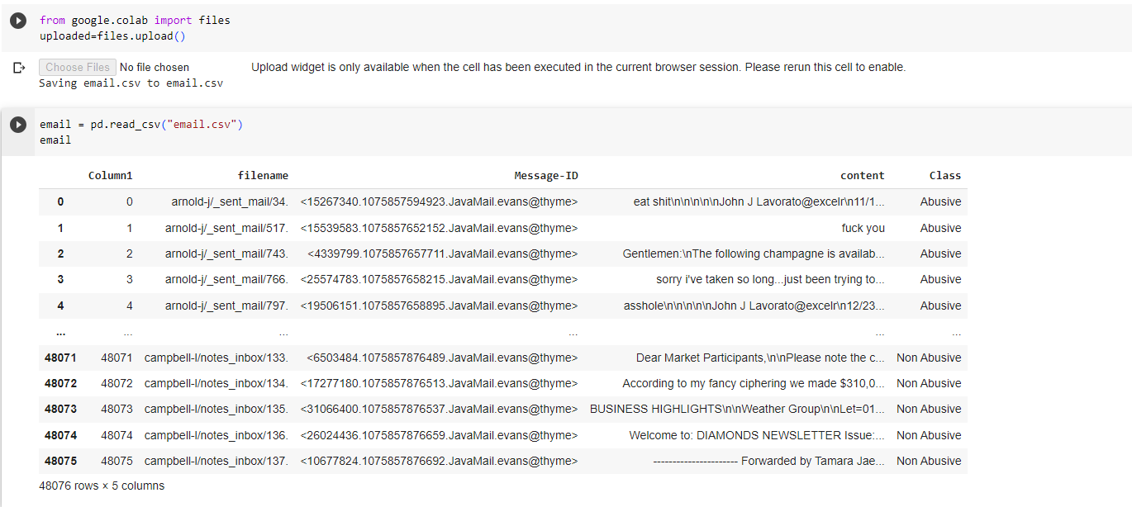
EDA
Importing Libraries
Reading the File

Slide 7
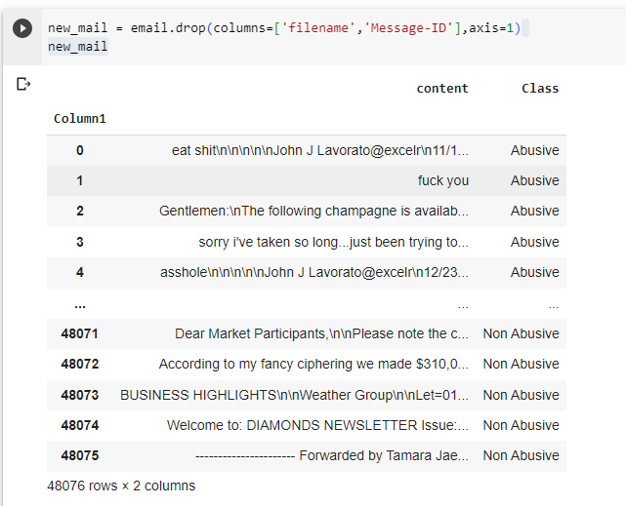
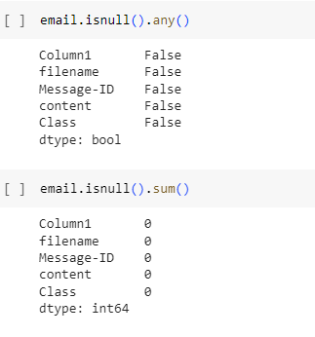
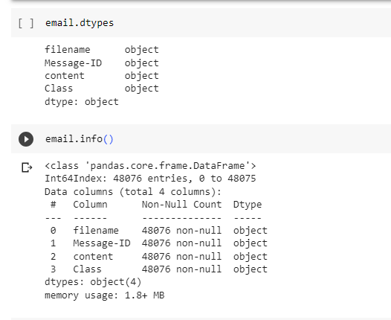
EDA
Removing Unwanted Columns
Checking Null values
Data types of Data Set

Slide 8
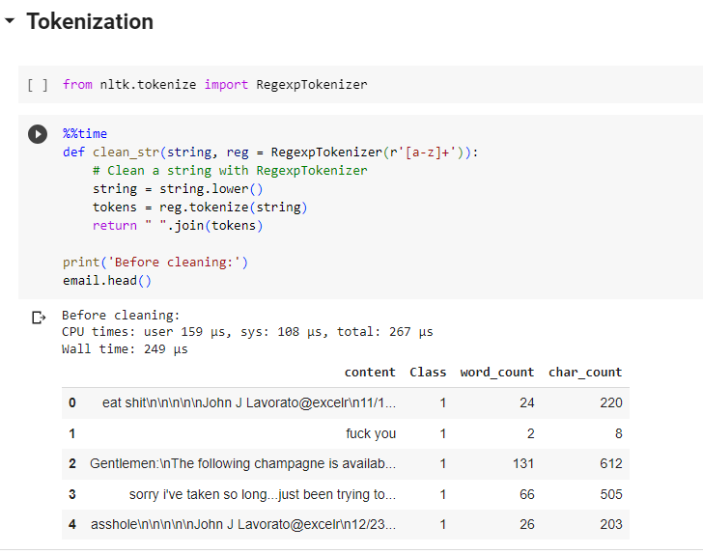
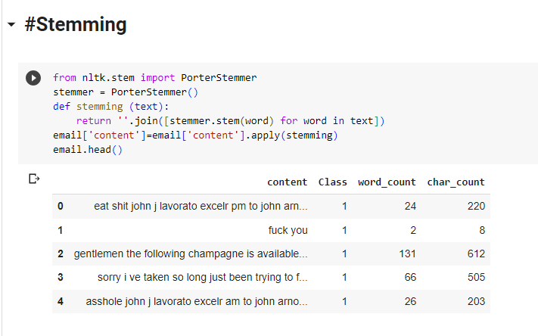
DATA PREPROCESSING

Slide 9
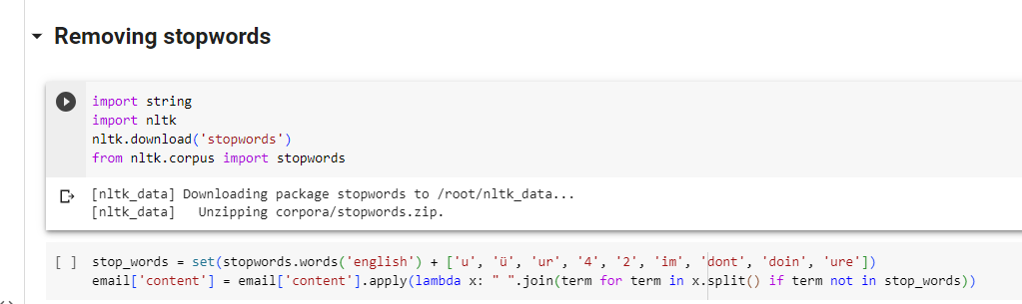
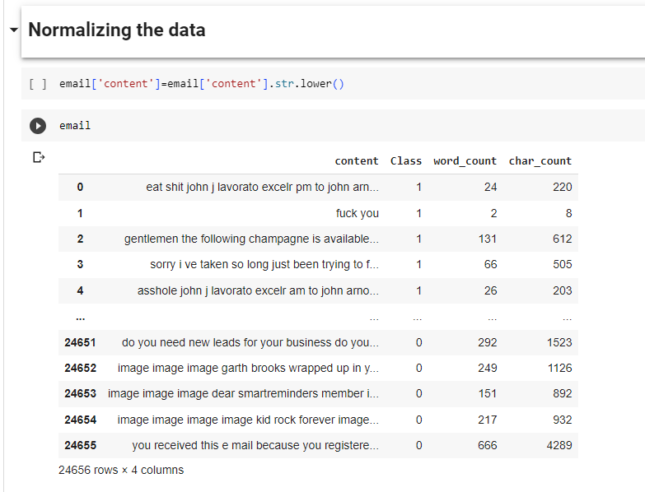
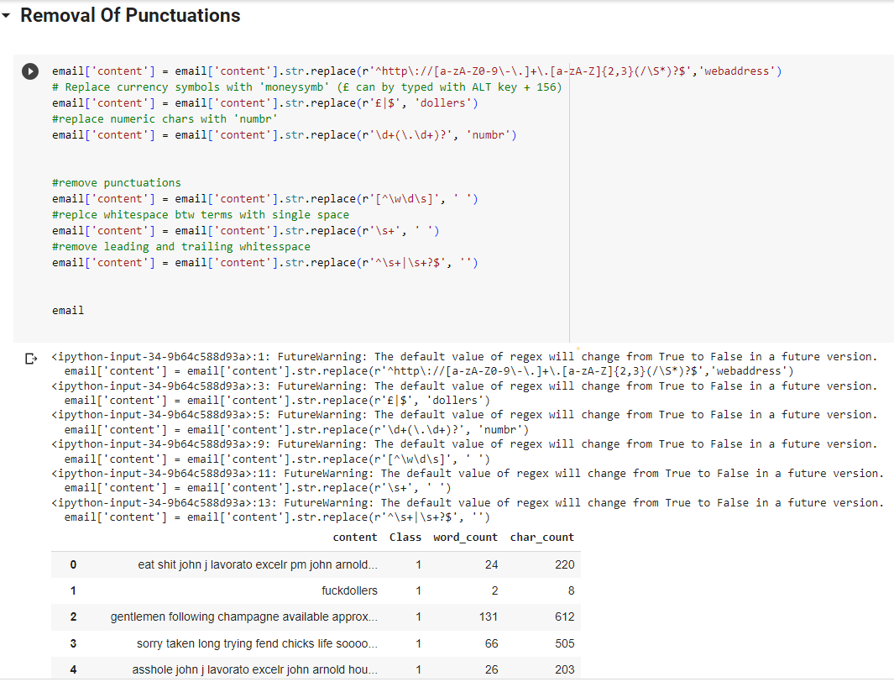
DATA PREPROCESSING

Slide 10
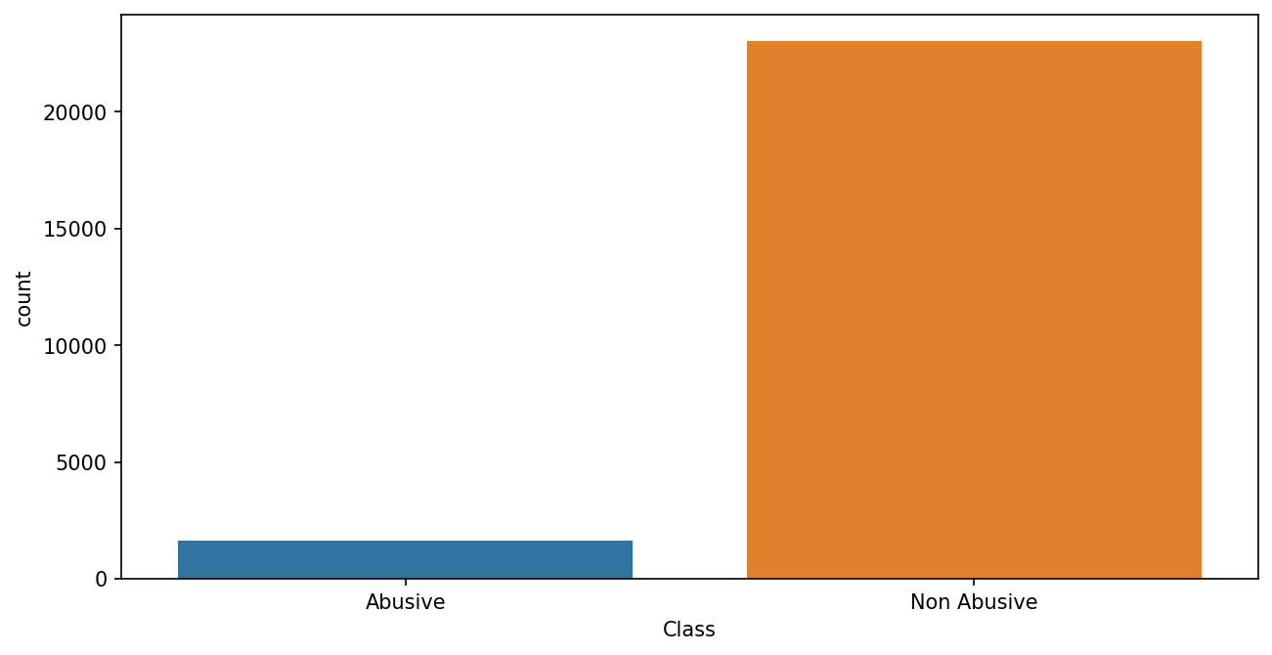
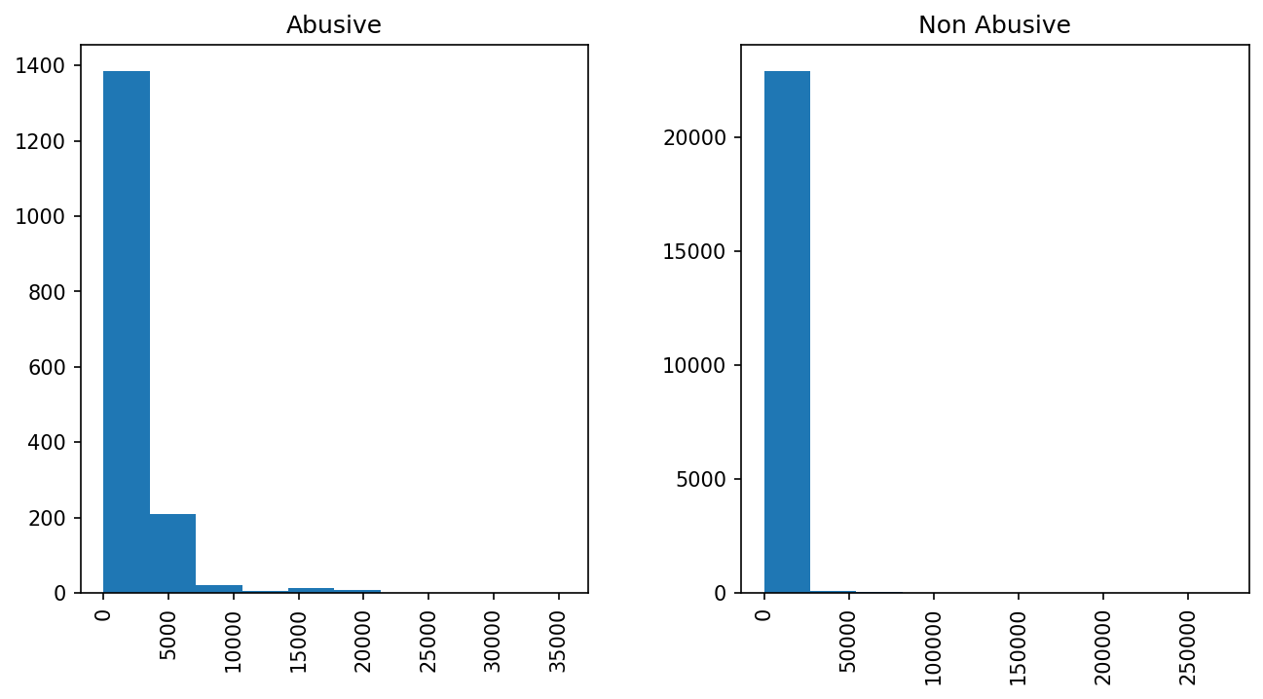
Count plot of abusive and non-abusive emails .
Histogram of Abusive and non-abusive mails based on the
length of the mail content

Slide 11
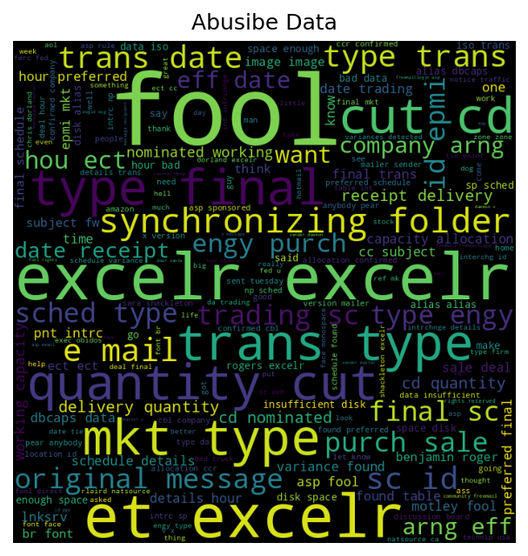
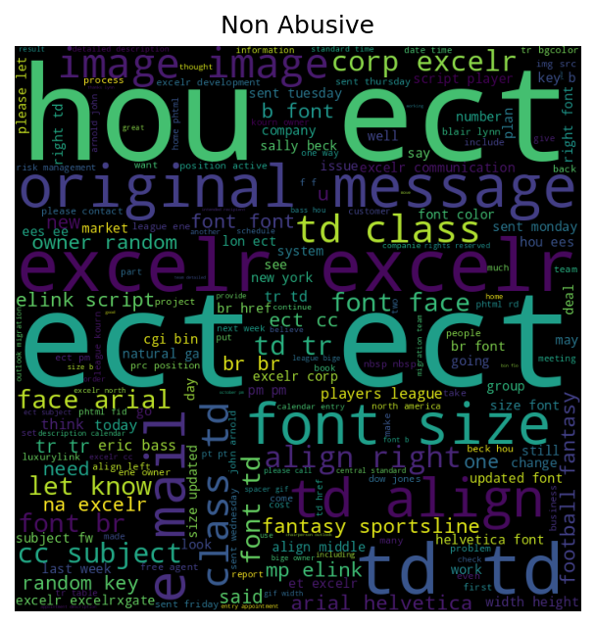
WORD CLOUD
Abusive Data

Slide 12
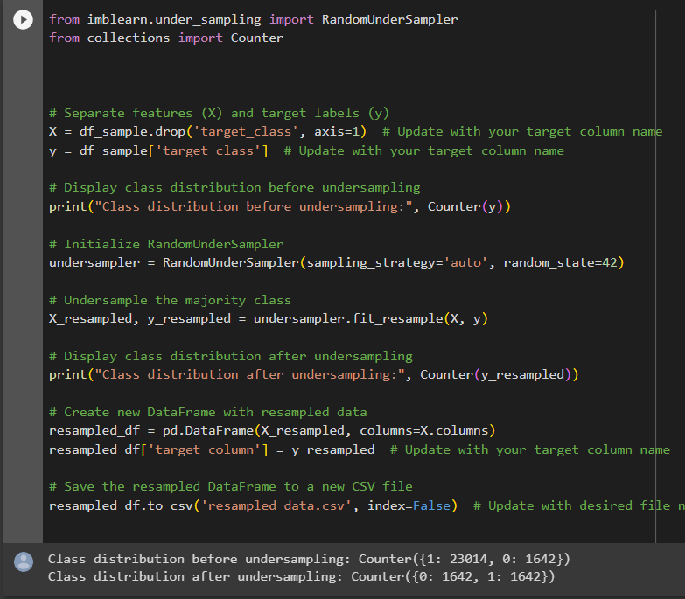
RESAMPLING DATA
FROM THE COUNTPLOT WE UNDERSTOOD THAT OUR DATA IS HIGHLY IMBALANCED. THEREFORE WE HAVE TO RESAMPLE OUR DATASET TO SOLVE THE DATA IMBALANCE PROBLEM.

Slide 13
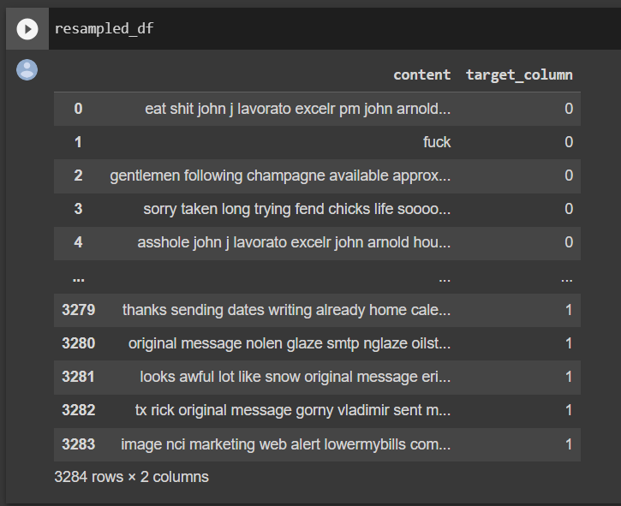
RESAMPLED DATASET

Slide 14
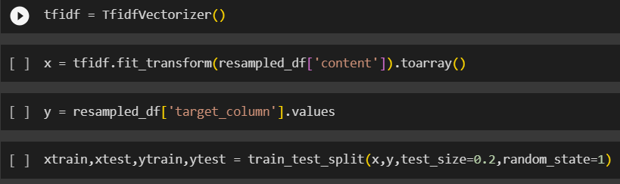
MODEL BUILDING
MODEL BUILDING IN AN NLP PROJECT IS AN COMPLICATED TASK WHERE WE HAVE TO KEEP THE DATA AS CLEAN AND TO ITS SIMPLEST FORM.
FOR TEXT PREDICTIONS WE HAVE TO KEEP DATA IN ITS SIMPLEST FORM.
IT IS REQUIRED TO REMOVE PUNCTUATIONS, SPECIAL CHARACTERS, AND NUMBERS. ALSO IT IS REQUIRED TO REMOVE STOP WORDS FROM THE DATA(LIKE: THE, IS, IN, ETC).
FINALLY WE ALSO HAVE TO LEMMATIZE THE TEXT DATA FOR CONVERSION INTO SIMPLIFIED FORM.
THIS COMPLETES THE PROCESS OF TEXT PRE-PROCESSING. AFTER WHICH THE DATA IS SET FOR MODEL BUILDING.
Setting up dataset on top of TF-IDF Vectorizer and splitting the train and test Data.

Slide 15
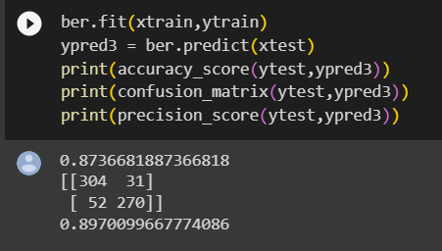
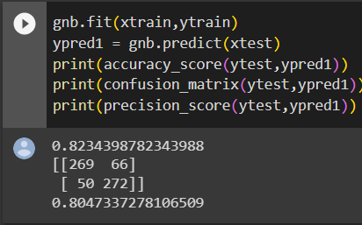
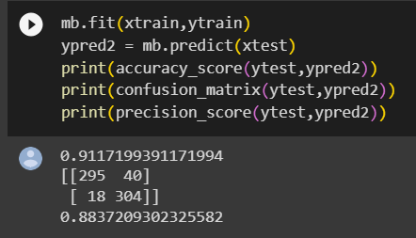
MODELS SELECTED
ON THE BASIS OF OUR RESEARCH AND ANALYSIS WE HAVE FINALIZED FEW CLASSIFIER MODELS TO WORK ON.
FIRST WE TRIED MOST FAMOUS NAÏVE BAYES CLASSIFIER WITH ALL ITS SUBTYPES, BERNOULLI, MULTINOMINAL, AND GAUSSIAN NAÏVE BAYES CLASSIFIER.
Bernoulli Naïve Bayes Classifier
Gaussian Naïve Bayes Classifier
Multinominal Naïve Bayes Classifier

Slide 16
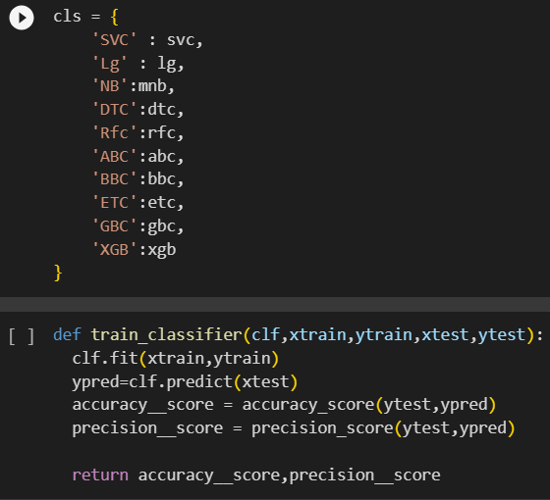
MODELS SELECTED
THEN WE TRIED ON MANY DIFFERENT CLASSIFICATION MODELS INCLUDING
SUPPORT VECTOR CLASSIFIER
REGRESSION CLASSIFIER
DECISION TREE
RANDOM FOREST
ADABOOST CLASSIFIER
GRADIENT BOOSTING CLASSIFIER, ETC

Slide 17
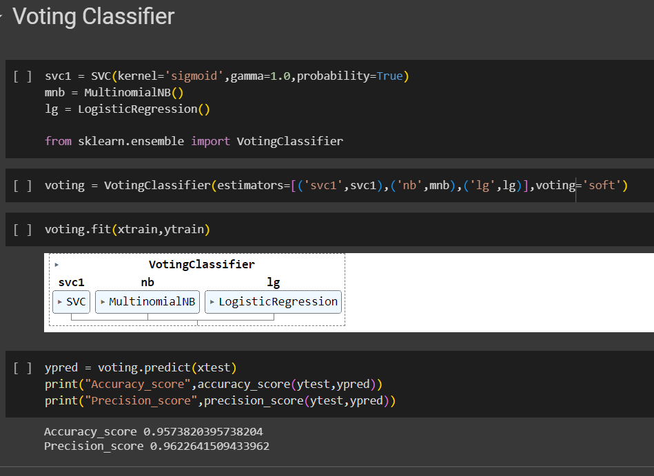

Slide 18
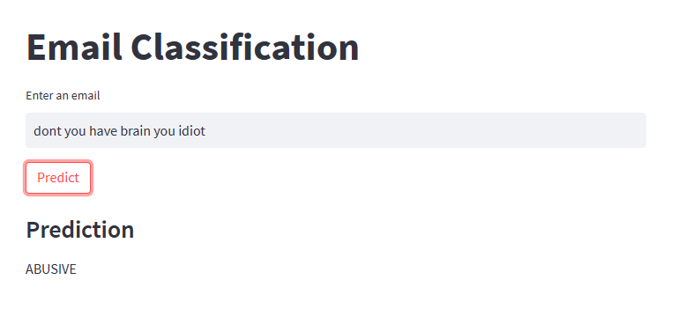

Slide 19
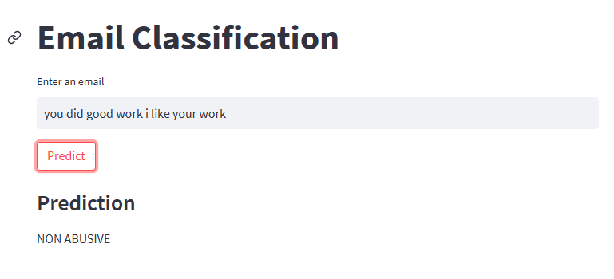

Slide 20


